Slide 1

Network+ Guide to Networks 6th Edition
Chapter 2
Networking Standards and the OSI Model

Slide 2
Objectives
Identify organizations that set standards for networking
Describe the purpose of the OSI model and each of its layers
Explain specific functions belonging to each OSI model layer

Slide 3
Objectives (cont’d.)
Understand how two network nodes communicate through the OSI model
Discuss the structure and purpose of data packets and frames
Describe the two types of addressing covered by the OSI model

Slide 4
Networking Standards Organizations
Standard
Documented agreement
Technical specifications/precise criteria
Stipulates design or performance of particular product or service
Standards are essential in the networking world
Wide variety of hardware and software
Ensures network design compatibility
Standards define minimum acceptable performance
Not ideal performance

Slide 5
Networking Standards Organizations (cont’d.)
Many different organizations oversee computer industry standards
Organizations may overlap responsibilities
Example: ANSI and IEEE set wireless standards
Network professional’s responsibility
Be familiar with groups setting networking standards
Understand critical aspects of standards required by own networks

Slide 6
ANSI
ANSI (American National Standards Institute)
1000+ representatives from industry and government
Determines standards for electronics industry and other fields
Requests voluntarily compliance with standards
Obtaining ANSI approval requires rigorous testing
ANSI standards documents available online

Slide 7
EIA
EIA (Electronic Industries Alliance)
Trade organization
Representatives from United States electronics manufacturing firms
Sets standards for its members
Helps write ANSI standards
Lobbies for favorable computer and electronics industries legislation

Slide 8
TIA
TIA (Telecommunications Industry Association)
Formed in 1988
EIA subgroup merged with former United States Telecommunications Suppliers Association (USTSA)
Focus of TIA
Standards for information technology, wireless, satellite, fiber optics, and telephone equipment
TIA/EIA 568-B Series
Guidelines for installing network cable in commercial buildings

Slide 9
IEEE
IEEE (Institute of Electrical and Electronics Engineers)
International engineering professionals society
Goal of IEEE
Promote development and education in electrical engineering and computer science fields
Hosts symposia, conferences, and chapter meetings
Maintains a standards board
IEEE technical papers and standards
Highly respected

Slide 10
ISO
ISO (International Organization for Standardization)
Headquartered in Geneva, Switzerland
Collection of standards organizations
Representing 57 countries
Goal of ISO
Establish international technological standards to facilitate global exchange of information and barrier free trade
Widespread authority

Slide 11
ITU
ITU (International Telecommunication Union)
Specialized United Nations agency
Regulates international telecommunications
Provides developing countries with technical expertise and equipment
Founded in 1865
Joined United Nations in 1947
Members from 191 countries
Focus of ITU
Global telecommunications issues
Worldwide Internet services implementation

Slide 12
ISOC
ISOC (Internet Society)
Founded in 1992
Professional membership society
Establishes technical Internet standards
Current ISOC concerns
Rapid Internet growth
Keeping Internet accessible
Information security
Stable Internet addressing services
Open standards

Slide 13
ISOC (cont’d.)
ISOC oversees groups with specific missions
IAB (Internet Architecture Board)
Technical advisory group
Overseeing Internet’s design and management
IETF (Internet Engineering Task Force)
Sets Internet system communication standards
Particularly protocol operation and interaction
Anyone may submit standard proposal
Elaborate review, testing, and approval processes

Slide 14
IANA
IP (Internet Protocol) address
Address identifying computers in TCP/IP based (Internet) networks
Reliance on centralized management authorities
IP address management history
Initially: IANA (Internet Assigned Numbers Authority)
1997: Three RIRs (Regional Internet Registries)
ARIN (American Registry for Internet Numbers)
APNIC (Asia Pacific Network Information Centre)
RIPE (Réseaux IP Européens)

Slide 15
ICANN
IP address management history (cont’d.)
Late 1990s: ICANN (Internet Corporation for Assigned Names and Numbers)
Private nonprofit corporation
Remains responsible for IP addressing and domain name management
IANA performs system administration
Users and business obtain IP addresses from ISP (Internet service provider)

Slide 16
The OSI Model
Acronym for Open Systems Interconnection.
Model for understanding and developing network computer-to-computer communications
Developed by ISO (1980s)
Divides network communications into seven layers
Physical, Data Link, Network, Transport, Session, Presentation, Application
At each layer, protocols perform services unique to that layer.
While performing those services, the protocols also interact with protocols in the layers directly above and below.

Slide 17
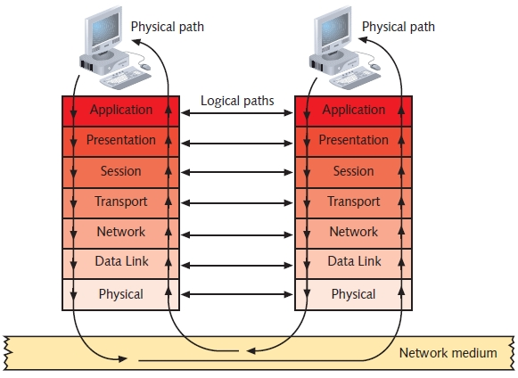
Figure 2.1 Flow of data through the OSI model

Slide 18
Application Layer
Layer 7; PDU: data
Does not include software applications however it must interact with your software applications.
Protocol functions
Facilitates communication between software applications and lower-layer network services
Network interprets application request
Application interprets data sent from network

Slide 19
Application Layer (cont’d.)
Software applications negotiate with application layer protocols
Formatting, procedural, security, synchronization, and other requirements
Example of Application layer protocol: HTTP

Slide 20
Presentation Layer
Layer 6; PDU: data
Protocol functions
Accept Application layer data
Format data
Understandable to different applications and hosts
Example: text encoding methods
Presentation layer protocols perform coding and compression
Example: Presentation layer services manage data encryption and decryption

Slide 21
Session Layer
Layer 5; PDU: data
Protocol functions
Coordinate and maintain communications between two nodes
Session
Connection for ongoing data exchange between two parties
Connection between remote client and access server
Connection between Web browser client and Web server

Slide 22
Session Layer (cont’d.)
Functions
Establishing and keeping alive communications link
For session duration
Keeping communications secure
Synchronizing dialogue between two nodes
Determining if communications ended
Determining where to restart transmission
Terminating communications

Slide 23
Transport Layer
Layer 4; PDU: segment
Protocol functions
Accept data from Session layer
Manage end-to-end data delivery
Handle flow control
Connection-oriented protocols
Establish connection before transmitting data
Checksum
Unique character string allowing receiving node to determine if arriving data unit exactly matches data unit sent by source
Further ensures data integrity

Slide 24
Transport Layer (cont’d.)
Connectionless protocols
Do not establish connection with another node before transmitting data
Make no effort to ensure data is delivered free of errors
More efficient than connection-oriented protocol
Useful when data must be transferred quickly
Segmentation
Breaking large data units received from Session layer into multiple smaller units called segments
Increases data transmission efficiency

Slide 25
Transport Layer (cont’d.)
MTU (maximum transmission unit)
Largest data unit network will carry
Ethernet default: 1500 bytes
Discovery routine used to determine MTU
Reassembly
Process of reconstructing segmented data units
Sequencing
Method of identifying segments belonging to the same group of subdivided data

Slide 26
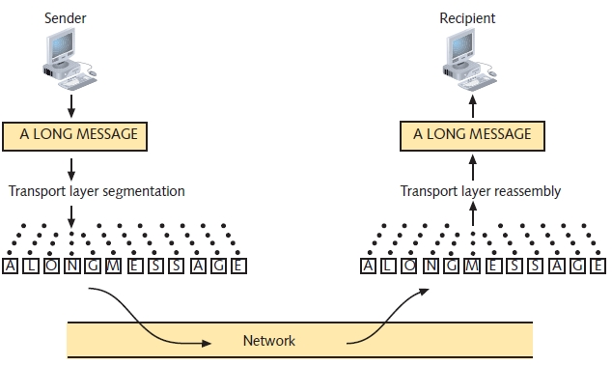
Transport Layer (cont’d.)
Figure 2-2 Segmentation and reassembly

Slide 27
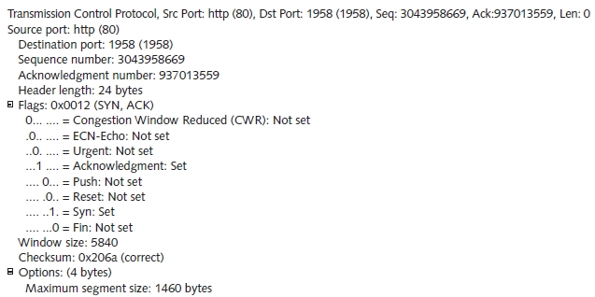
Transport Layer (cont’d.)
Figure 2-3 A TCP segment

Slide 28
Network Layer
Layer 3; PDU: packet
Protocols functions
Translate network addresses into physical counterparts
Decide how to route data from sender to receiver
Addressing
System for assigning unique identification numbers to network devices
Types of addresses for nodes
Network addresses
Logical addresses

Slide 29
Network Layer (cont’d.)
Packet formation
Transport layer segment appended
Logical addressing information
Routing
Determine path from point A on one network to point B on another network
Routing considerations
Delivery priorities, network congestion, quality of service, cost of alternative routes

Slide 30
Network Layer (cont’d.)
Common Network layer protocol
IP (Internet Protocol)
Fragmentation
Network layer protocol (IP) subdivides Transport layer segments received into smaller packets

Slide 31
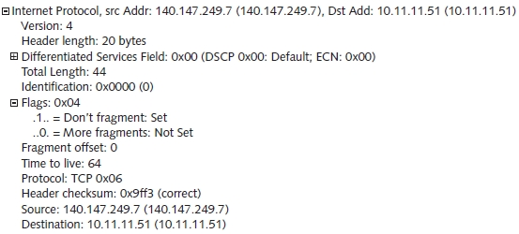
Network Layer (cont’d.)
Figure 2-4 An IP packet

Slide 32
Data Link Layer
Layer 2; PDU: frame (has header and trailer (FCS))
Function of protocols
Divide data received into distinct frames for transmission in Physical layer
Frame
Structured package for moving data
Includes raw data (payload), sender’s and receiver’s network addresses, error checking and control information

Slide 33
Data Link Layer (cont’d.)
Possible partial communication mishap
Not all information received
Corrected by error checking
Error checking
Frame check sequence
CRC (cyclic redundancy check)
Possible glut of communication requests
Data Link layer controls flow of information
Allows NIC to process data without error

Slide 34
Data Link Layer (cont’d.)
Two Data Link layer sublayers
LLC (Logical Link Control) sublayer
MAC (Media Access Control) sublayer
MAC address components
Block ID
Six-character sequence unique to each vendor
Device ID
Six-character number added at vendor’s factory
MAC addresses frequently depicted in hexadecimal format

Slide 35
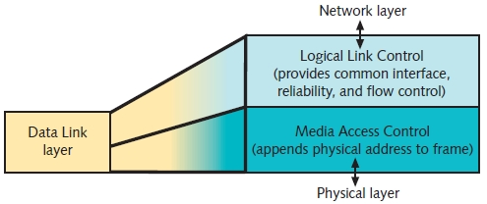
Data Link Layer (cont’d.)
Figure 2-5 The Data Link layer and its sublayers

Slide 36
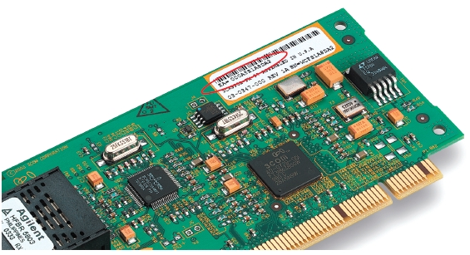
Data Link Layer (cont’d.)
Figure 2-6 A NIC’s Mac address

Slide 37
Physical Layer
Layer 1
Functions of protocols
Accept frames from Data Link layer
Generate signals as changes in voltage at the NIC
Copper transmission medium
Signals issued as voltage
Fiber-optic cable transmission medium
Signals issued as light pulses
Wireless transmission medium
Signals issued as electromagnetic waves

Slide 38
Physical Layer (cont’d.)
Physical layer protocols responsibility when receiving data
Detect and accept signals
Pass on to Data Link layer
Set data transmission rate
Monitor data error rates
No error checking
Devices operating at Physical layer
Hubs and repeaters
NICs operate at both Physical layer and Data Link layers

Slide 39
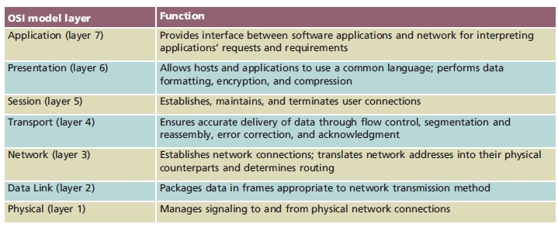
Applying the OSI Model
Table 2-1 Functions of the OSI layers

Slide 40
Communication Between Two Systems
Data transformation
Original software application data differs from application layer NIC data
Header data added at each layer
PDUs
Generated in Application layer
Segments
Generated in Transport layer
Unit of data resulting from subdividing larger PDU

Slide 41
Communication Between Two Systems (cont’d.)
Packets
Generated in Network layer
Data with logical addressing information added to segments
Frames
Generated in Data Link layer
Composed of several smaller components or fields

Slide 42
Communication Between Two Systems (cont’d.)
Encapsulation
Occurs in Data Link layer
Process of wrapping one layer’s PDU with protocol information
Allows interpretation by lower layer

Slide 43
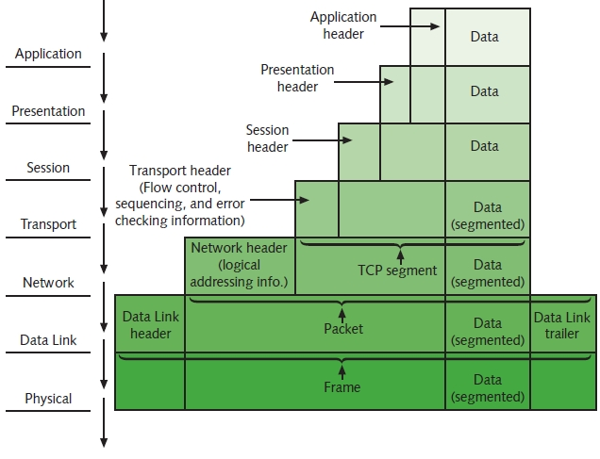
Communication Between Two Systems (cont’d.)
Figure 2-7 Data transformation through the OSI model

Slide 44
Data Frames in Network Communications
Reasons why networks split data into small pieces
Large units of data sent across a network hamper effective communications by saturating the network
If a sender and receiver use all the available bandwidth by sending large blocks of continuous data, other computers can’t readily communicate
Networks can sometimes be unreliable
Retransmission of large frames (due to errors) is inefficient

Slide 45
Frame Specifications
Frames
Composed of several smaller components or fields
Frame characteristic dependencies
Network type where frames run
Standards frames must follow
Ethernet
Developed by Xerox
Four different types of Ethernet frames
Most popular: IEEE 802.3 standard

Slide 46
Frame Specifications (cont’d.)
Token ring
Developed by IBM
Relies upon direct links between nodes and ring topology
Nearly obsolete
Defined by IEEE 802.5 standard
Ethernet frames and token ring frames differ
Will not interact with each other
Devices cannot support more than one frame type per physical interface or NIC

Slide 47
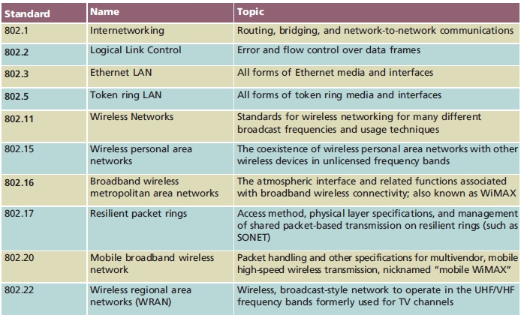
IEEE Networking Specifications (cont’d.)
Table 2-2 IEEE 802 standards

Slide 48
Summary
Standards and standard organizations
ISO’s OSI (Open Systems Interconnection) model
Seven layers
IEEE’s Project 802
Significant IEEE 802 standards

